Slide 1
IcedHops: Reducing Read and Write Latency in an Iceberg-Backed Offline Feature Store
3rd April 2025
Sebastiano Meneghin – sebastiano.meneghin@mail.polimi.it

Slide 2

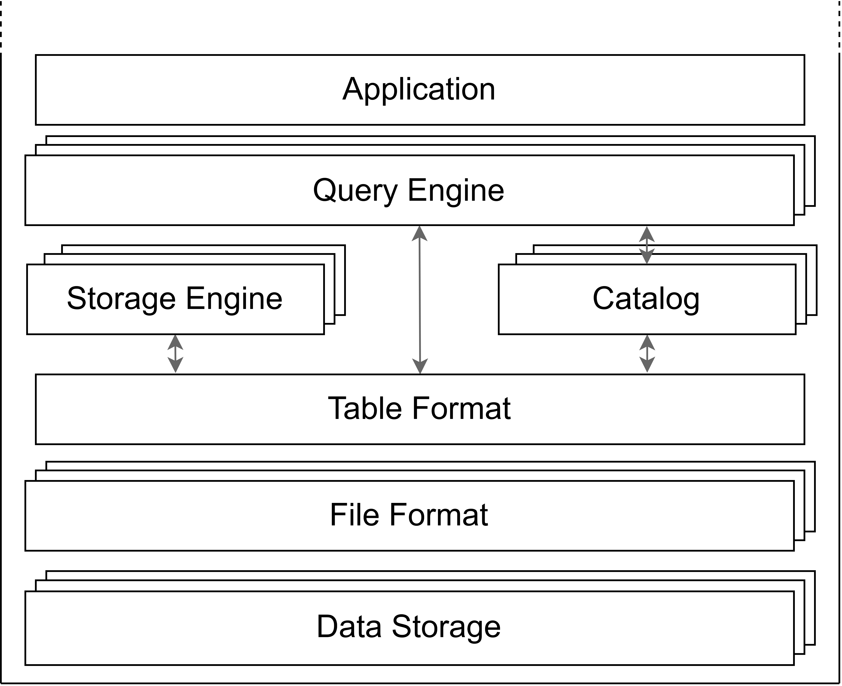
What is a data lakehouse?
Data lake + Data warehouse
Supports:
All data types
ACID properties
Interoperability
Notes:
Emerged in 2017, a data lakehouse integrate structure ad unstructured data storage capabilities of data lakes, while maintaining the governance, the ACID compliance, and the analytics capabilities of a data warehouse.
It enables organizations to use a single storage for all the types of data, while supporting high-performance SQL queries, as well as ML workloads.
By their design, several data lakehouses ensure interoperatbility with various query engines, table formats and file formats, avoiding the risk of getting data locked into a proprietary solution.

Slide 3
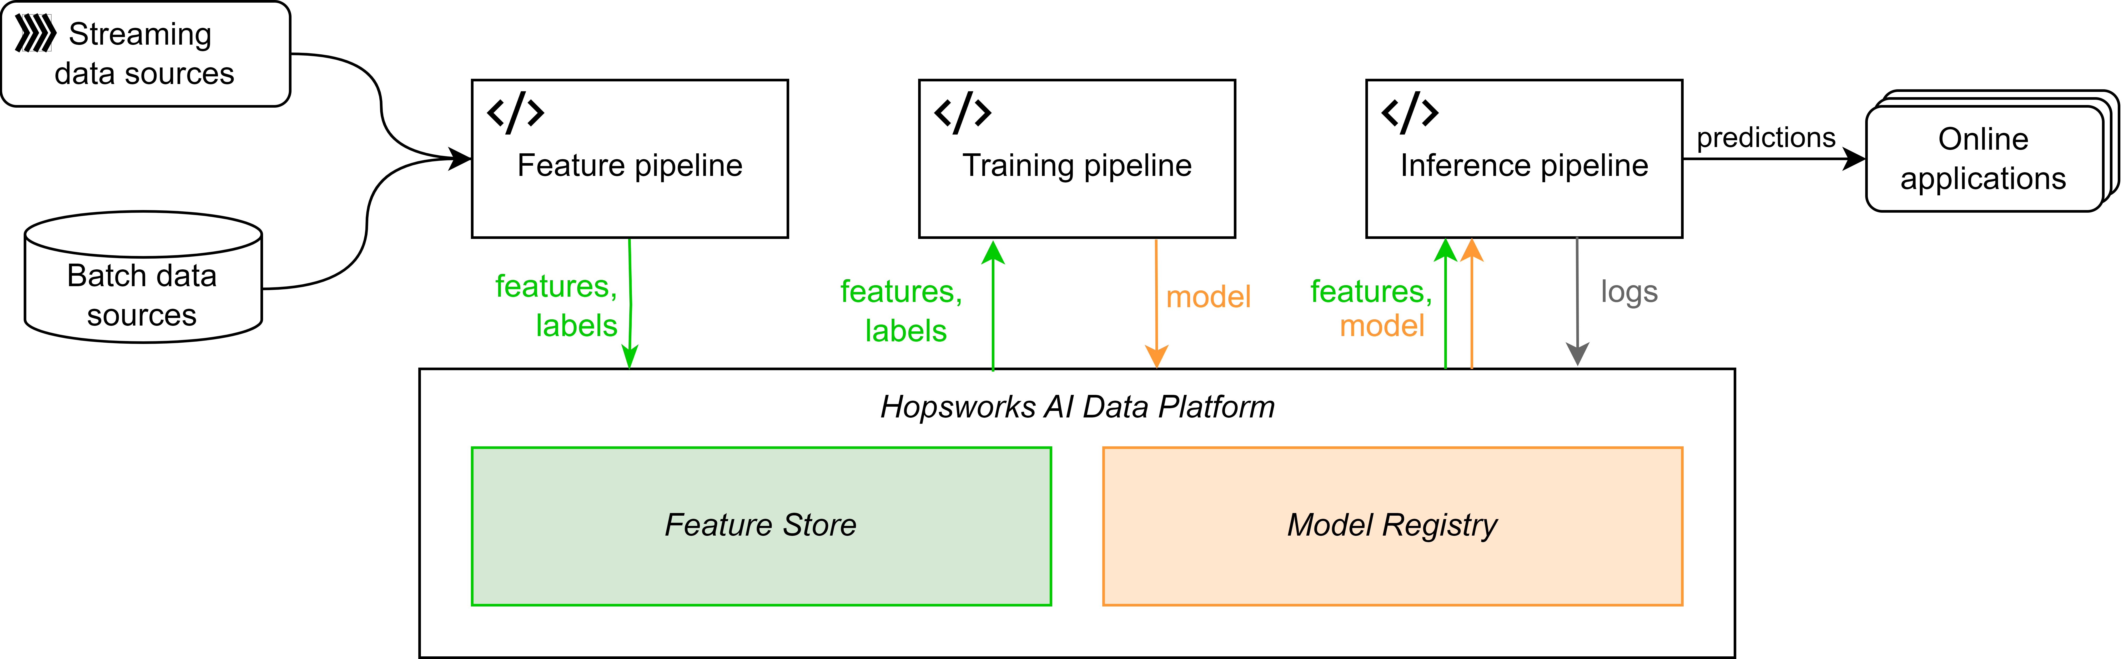
What is a feature store?
Data versioning for ML pipelines
Enable feature reusability
Usually coupled with a model registry

Slide 4
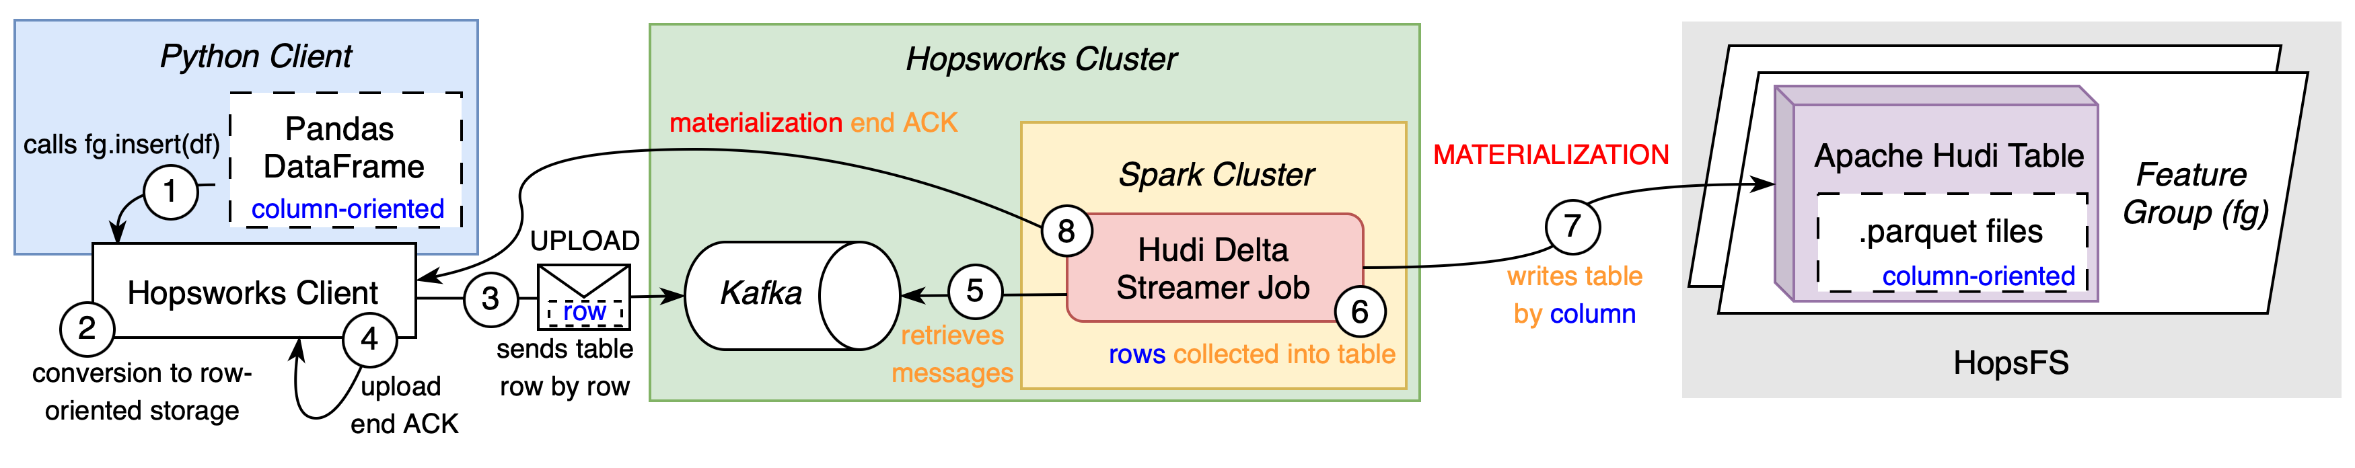
Hopsworks offline feature store - Writing
[1] De La Rúa Martínez, Javier, Fabio Buso, Antonios Kouzoupis, Alexandru A. Ormenisan, Salman Niazi, Davit Bzhalava, Kenneth Mak, et al. 2024. “The Hopsworks Feature Store for Machine Learning.” SIGMOD/PODS ’24: Companion of the 2024 International Conference on Management of Data, May. https://doi.org/10.1145/3626246.3653389.
[2] https://docs.hopsworks.ai/latest/
Notes:
The current writing operation on the legacy Hudi-based system, is quite complex.
There are three tiers involved, the Python client, the Hopsworks cluster, and HopsFS.
The Python client is where the Hopsworks API is used to read and write data on the underlying system. When data are sent via the network, are converted from column oriented formats to row oriented. Each row is uploaded on Kafka, as a single message. Then the Hudi delta streamer, a Spark job triggered with a specified recurrency, takes those rows from the dedicated Kafka topics and “materialize” them in the Hudi tables saved on HopsFS.

Slide 5
Hopsworks offline feature store - Writing
[1] De La Rúa Martínez, Javier, Fabio Buso, Antonios Kouzoupis, Alexandru A. Ormenisan, Salman Niazi, Davit Bzhalava, Kenneth Mak, et al. 2024. “The Hopsworks Feature Store for Machine Learning.” SIGMOD/PODS ’24: Companion of the 2024 International Conference on Management of Data, May. https://doi.org/10.1145/3626246.3653389.
[2] https://docs.hopsworks.ai/latest/
Notes:
The current writing operation on the legacy Hudi-based system, is quite complex.
There are three tiers involved, the Python client, the Hopsworks cluster, and HopsFS.
The Python client is where the Hopsworks API is used to read and write data on the underlying system. When data are sent via the network, are converted from column oriented formats to row oriented. Each row is uploaded on Kafka, as a single message. Then the Hudi delta streamer, a Spark job triggered with a specified recurrency, takes those rows from the dedicated Kafka topics and “materialize” them in the Hudi tables saved on HopsFS.

Slide 6
Hopsworks offline feature store - Writing
[1] De La Rúa Martínez, Javier, Fabio Buso, Antonios Kouzoupis, Alexandru A. Ormenisan, Salman Niazi, Davit Bzhalava, Kenneth Mak, et al. 2024. “The Hopsworks Feature Store for Machine Learning.” SIGMOD/PODS ’24: Companion of the 2024 International Conference on Management of Data, May. https://doi.org/10.1145/3626246.3653389.
[2] https://docs.hopsworks.ai/latest/
Notes:
The current writing operation on the legacy Hudi-based system, is quite complex.
There are three tiers involved, the Python client, the Hopsworks cluster, and HopsFS.
The Python client is where the Hopsworks API is used to read and write data on the underlying system. When data are sent via the network, are converted from column oriented formats to row oriented. Each row is uploaded on Kafka, as a single message. Then the Hudi delta streamer, a Spark job triggered with a specified recurrency, takes those rows from the dedicated Kafka topics and “materialize” them in the Hudi tables saved on HopsFS.

Slide 7
Hopsworks offline feature store - Writing
[1] De La Rúa Martínez, Javier, Fabio Buso, Antonios Kouzoupis, Alexandru A. Ormenisan, Salman Niazi, Davit Bzhalava, Kenneth Mak, et al. 2024. “The Hopsworks Feature Store for Machine Learning.” SIGMOD/PODS ’24: Companion of the 2024 International Conference on Management of Data, May. https://doi.org/10.1145/3626246.3653389.
[2] https://docs.hopsworks.ai/latest/
Notes:
The current writing operation on the legacy Hudi-based system, is quite complex.
There are three tiers involved, the Python client, the Hopsworks cluster, and HopsFS.
The Python client is where the Hopsworks API is used to read and write data on the underlying system. When data are sent via the network, are converted from column oriented formats to row oriented. Each row is uploaded on Kafka, as a single message. Then the Hudi delta streamer, a Spark job triggered with a specified recurrency, takes those rows from the dedicated Kafka topics and “materialize” them in the Hudi tables saved on HopsFS.

Slide 8
Hopsworks offline feature store - Writing
[1] De La Rúa Martínez, Javier, Fabio Buso, Antonios Kouzoupis, Alexandru A. Ormenisan, Salman Niazi, Davit Bzhalava, Kenneth Mak, et al. 2024. “The Hopsworks Feature Store for Machine Learning.” SIGMOD/PODS ’24: Companion of the 2024 International Conference on Management of Data, May. https://doi.org/10.1145/3626246.3653389.
[2] https://docs.hopsworks.ai/latest/
Notes:
The current writing operation on the legacy Hudi-based system, is quite complex.
There are three tiers involved, the Python client, the Hopsworks cluster, and HopsFS.
The Python client is where the Hopsworks API is used to read and write data on the underlying system. When data are sent via the network, are converted from column oriented formats to row oriented. Each row is uploaded on Kafka, as a single message. Then the Hudi delta streamer, a Spark job triggered with a specified recurrency, takes those rows from the dedicated Kafka topics and “materialize” them in the Hudi tables saved on HopsFS.

Slide 9
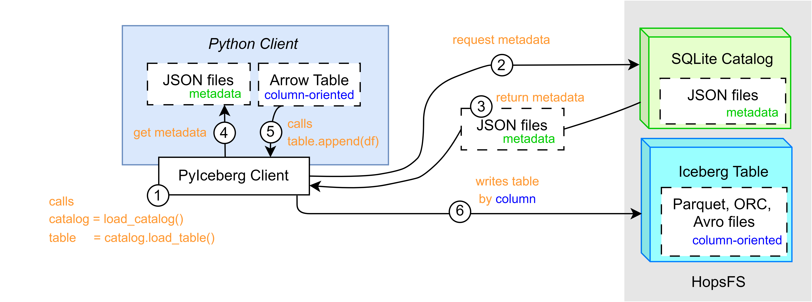
IcedHops - Writing
9
Notes:
IcedHops, the new system based on PyIceberg, aims at streamlining the read operation by:
- Removing the middle-tier, consisting on Kafka and Hudi delta streamer
- Providing column-based transfer, avoiding thus format-conversion and serialization overheads.
- Removing Spark for the equation
However, the integration PyIceberg and HopsFS… did not exist

Slide 10
IcedHops - Writing
10
Notes:
IcedHops, the new system based on PyIceberg, aims at streamlining the read operation by:
- Removing the middle-tier, consisting on Kafka and Hudi delta streamer
- Providing column-based transfer, avoiding thus format-conversion and serialization overheads.
- Removing Spark for the equation
However, the integration PyIceberg and HopsFS… did not exist

Slide 11
IcedHops - Writing
11
Notes:
IcedHops, the new system based on PyIceberg, aims at streamlining the read operation by:
- Removing the middle-tier, consisting on Kafka and Hudi delta streamer
- Providing column-based transfer, avoiding thus format-conversion and serialization overheads.
- Removing Spark for the equation
However, the integration PyIceberg and HopsFS… did not exist

Slide 12
Research Questions
RQ1: possible to integrate IcedHops?

Slide 13
Research Questions
RQ1: possible to integrate IcedHops?
Differences in read and write latency and throughput on the Hopsworks offline feature store, between the:
RQ2: legacy system and IcedHops

Slide 14
Research Questions
RQ1: possible to integrate IcedHops?
Differences in read and write latency and throughput on the Hopsworks offline feature store, between the:
RQ2: legacy system and IcedHops
RQ3: IcedHops and the delta-rs system

Slide 15
Methodology
RQ1: possible to integrate IcedHops?
Differences in read and write latency and throughput on the Hopsworks offline feature store, between the:
RQ2: legacy system and IcedHops
RQ3: IcedHops and the delta-rs system

Slide 16
Methodology
System integration
RQ1: possible to integrate IcedHops?
Differences in read and write latency and throughput on the Hopsworks offline feature store, between the:
RQ2: legacy system and IcedHops
RQ3: IcedHops and the delta-rs system

Slide 17
Methodology
System integration
System evaluation
RQ1: possible to integrate IcedHops?
Differences in read and write latency and throughput on the Hopsworks offline feature store, between the:
RQ2: legacy system and IcedHops
RQ3: IcedHops and the delta-rs system

Slide 18
Methodology
System integration
System evaluation
aaaaaaaaaaaaaaaaaa
System evaluation
RQ1: possible to integrate IcedHops?
Differences in read and write latency and throughput on the Hopsworks offline feature store, between the:
RQ2: legacy system and IcedHops
RQ3: IcedHops and the delta-rs system

Slide 19
IcedHops – Design choices (1/7)
Notes:
Settled the use requirements and the use case, PyIceberg has been integrated with HopsFS. This procedure tackled one by one the various part of a data lakehouse architecture, thus of a feature store, choosing the one which was the most appropriate. Let’s investigate one by one those choices, starting with the constrained by this research scope.

Slide 20
IcedHops – Design choices (1/7)
Hopsworks
Notes:
Being Hopsworks the industrial partner, the application interested in this system would be Hopsworks offline feature store.

Slide 21
IcedHops – Design choices (2/7)
Hopsworks
Iceberg
Notes:
As a second choice, as getting from the name, Iceberg is the choice for the Table Format.
Again, the three table format sharing most of the market are Iceberg, Hudi, employed in Hopsworks legacy system, and Delta Lake, used in the delta-rs related work.

Slide 22
IcedHops – Design choices (3/7)
Hopsworks
Iceberg
HopsFS
Notes:
HopsFS is the HDFS Hopsworks distribution, and it is at the base of the Hopsworks offline feature store, this also the Data Storage was a granted choice.

Slide 23
IcedHops – Design choices (4/7)
Hopsworks
Iceberg
HopsFS
HopsFS + Iceberg
Notes:
The storage engine is the part of the data lakehouse architecture which handles the data management tasks, aimed at optimizing efficiency of queries over the data. It generally performs data compation, indexing and partitioning. In this specific case, Iceberg already takes care of this for the metadata layer, while the HopsFS handles those operations on the physical layer, or data layer. Thus, no other specific technologies needed to be plugged in.

Slide 24
IcedHops – Design choices (4/7)
Hopsworks
HopsFS + PyIceberg
Iceberg
HopsFS
Notes:
Okk, let’s save these information in the schema, and proceed with the one with lesser constraints.

Slide 25
IcedHops – Design choices (5/7)
Hopsworks
HopsFS + PyIceberg
Iceberg
HopsFS

Slide 26
IcedHops – Design choices (5/7)
Avro
ORC
Parquet
Hopsworks
HopsFS + PyIceberg
Iceberg
HopsFS
Notes:
In this context, HopsFS is agnostic of the kind of files saved on the top of it. Iceberg support three different column-based file format, which are Avro, ORC, and Parquet. While Hudi, supports the three of them as well, Delta Lake only support Parquet.
Thus, to allow a fair comparison of the three systems, Parquet has been chosen for the experiments conducted on this system. However, IcedHops, already support those three file formats.

Slide 27
IcedHops – Design choices (6/7)
Hopsworks
HopsFS + PyIceberg
Iceberg
Parquet
HopsFS
Notes:
Let’s have a look at the Query Engine.

Slide 28
IcedHops – Design choices (6/7)
AWS Athena
Snowflake
Spark
Presto
Trino
Flink
DuckDB [4,5]
Hopsworks
HopsFS + PyIceberg
Iceberg
Parquet
HopsFS
[4] Khazanchi, 2023. ”Faster reading with DuckDB and Arrow Flight on Hopsworks: benchmark and performances evaluation of offline feature stores”. KTH, Royal Institute of Technology
[5] Rassveldt, Muhleisen. ”DuckDB: An Embeddable Analytical Database” in Proceedings of the 2019 International Conference on Management of Data, SIGMOD 19..
Notes:
PyIceberg support several Query Engines, despite this being less than the one supported by other Iceberg libraries (for example the Java ones).
AWS Athena, and Snowflake, has been discarded a-priori, as they are proprietary solutions, and would have thus lowered the reproducibility of the experiments, as well as accounting to additional costs.
Spark was discarded as directly violating the purpose of this project, which is creating a Spark free alternative
Presto, Trino and Flink, were discared since, as Spark, are designed to perform their best in large-scale data scenarios. Furthermore, being complex system, did not fulfil the maintainability not-functional requirements described before.
Duck, was the final choice, as it is a portable open-source OLAP-DBMS, which also proved to be the best performing engine in related work on small-scale scenarios.

Slide 29
IcedHops – Design choices (7/7)
Hopsworks
DuckDB
HopsFS + PyIceberg
Iceberg
Parquet
HopsFS
Notes:
Finally, let’s have a look at the Catalog.

Slide 30
IcedHops – Design choices (7/7)
REST
AWS Glue
AWS DynamoDB
Hive MS
SQL Catalog
Hopsworks
DuckDB
HopsFS + PyIceberg
Iceberg
Parquet
HopsFS
Notes:
The Catalog keeps track of information about each table (name, column, data types) and a reference of the metadata for each table (depending on the table format).
A REST catalog is by design the most integrable solution and thus is supported by HopsFS. However, this does not fulfil the maintainability requirements, as it should be built from scratch.
AWS Glue and DynamoDB, as proprietary solutions, has been discarded a-priori, following the same reasoning of the discarded prioprietary query engines.
Hive Metastore is supported by HopsFS. However, it is a complex tool, initially developed to by tightly integrated with MapReduce and Spark environments and perhaps perform its best in large-scale data scenarios.
SQL Catalog, it is supported by HopsFS and it could be instanciated on a light-weight SQLite database supported by PyIceberg. It is an open-source catalog and needs few lines of code to be used, fulfilling both the not-functional and functional requirements.

Slide 31
Experiments
Write
Read
Notes:
1 CPU, 2 CPU, 4 CPU, 8 CPU
10K, 100K, 1M, 6M, 60M rows
Read and Write
50 times each

Slide 32

Experiments
Write
Read
1
2
4
8 CPUS
Notes:
1 CPU, 2 CPU, 4 CPU, 8 CPU
10K, 100K, 1M, 6M, 60M rows
Read and Write
50 times each

Slide 33
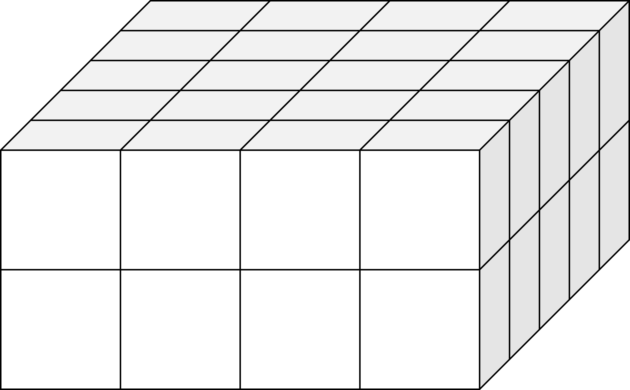
Experiments
60M
6M
1M
100k
10k
Write
Read
1
2
4
8 CPUS
Notes:
1 CPU, 2 CPU, 4 CPU, 8 CPU
10K, 100K, 1M, 6M, 60M rows
Read and Write
50 times each

Slide 34
Experiments
60M
6M
1M
100k
10k
50x
Write
Read
1
2
4
8 CPUS
Notes:
1 CPU, 2 CPU, 4 CPU, 8 CPU
10K, 100K, 1M, 6M, 60M rows
Read and Write
50 times each

Slide 35
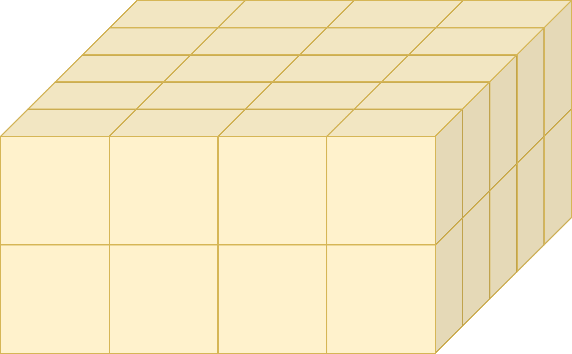
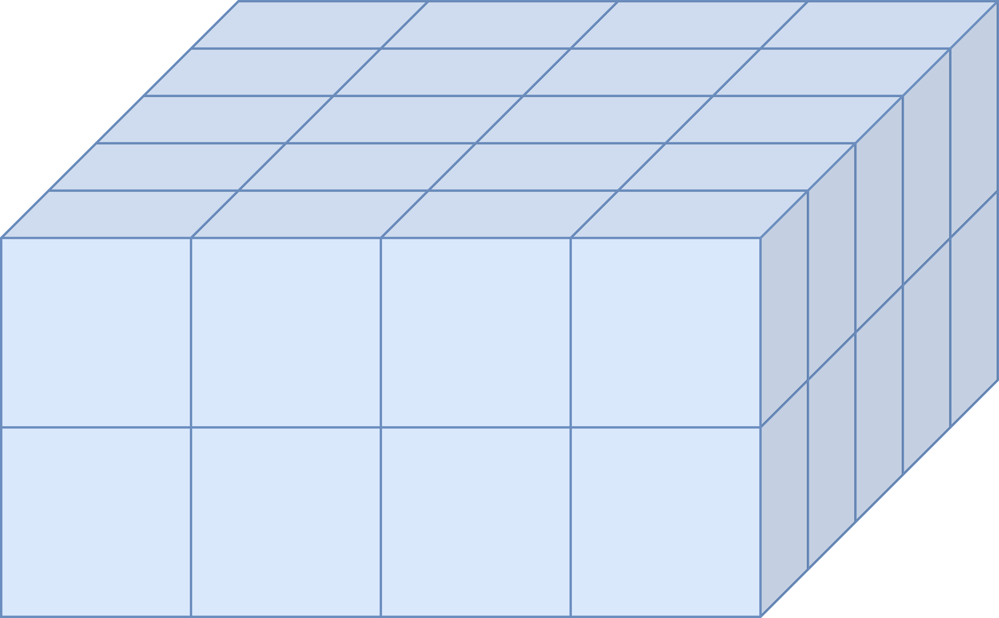
Experiments
Legacy
IcedHops
Notes:
1 CPU, 2 CPU, 4 CPU, 8 CPU
10K, 100K, 1M, 6M, 60M rows
Read and Write
50 times each

Slide 36
Takeaways - Write
Legacy
IcedHops
delta-rs
50s – 45min
+10% on 2 CPUs
0.7s – 34s
+0% on 2 CPUs
1s – 24s
+5% on 2 CPUs
0.02s – 22s
+40% on 2 CPUs
1s – 3min
+25% on 2 CPUs
0.05s – 23s
+50% on 2 CPUs

Slide 37
Takeaways - Read
Legacy
IcedHops
delta-rs
50s – 45min
+10% on 2 CPUs
0.7s – 34s
+0% on 2 CPUs
1s – 24s
+5% on 2 CPUs
0.02s – 22s
+40% on 2 CPUs
1s – 3min
+25% on 2 CPUs
0.05s – 23s
+50% on 2 CPUs

Slide 38
Takeaways
IcedHops
40-140x write
55%-60x read
Best in 88% tests
delta-rs
6-40x write
45%-40x read
Best multi-core
scalability
Legacy
Slowest in 100% tests

Slide 39
Research questions
RQ1: possible to integrate IcedHops?
Notes:
Jumping back to the beginning. The research questions delineated while starting this project were:
Which are the difference for read and write latency and throughput, between:
The legacy system and IcedHops
IcedHops and the delta-rs system
Now, given the results and their analysis, we can draw our conclusion.

Slide 40
Research questions
RQ1: possible to integrate IcedHops?
Notes:
Jumping back to the beginning. The research questions delineated while starting this project were:
Which are the difference for read and write latency and throughput, between:
The legacy system and IcedHops
IcedHops and the delta-rs system
Now, given the results and their analysis, we can draw our conclusion.

Slide 41
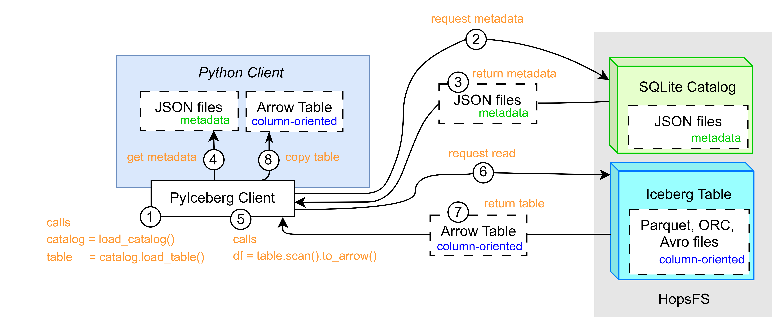
Research questions
RQ1: possible to integrate IcedHops?
Notes:
Jumping back to the beginning. The research questions delineated while starting this project were:
Which are the difference for read and write latency and throughput, between:
The legacy system and IcedHops
IcedHops and the delta-rs system
Now, given the results and their analysis, we can draw our conclusion.

Slide 42
Research questions
Differences in read and write latency and throughput between:
RQ2: legacy system and IcedHops.
RQ3: IcedHops and the delta-rs system.
42
Notes:
Jumping back to the beginning. The research questions delineated while starting this project were:
Which are the difference for read and write latency and throughput, between:
The legacy system and IcedHops
IcedHops and the delta-rs system
Now, given the results and their analysis, we can draw our conclusion.

Slide 43
Research questions
Conclusions
Differences in read and write latency and throughput between:
RQ2: legacy system and IcedHops.
RQ3: IcedHops and the delta-rs system.
IcedHops fulfils all the system requirements.
This solution can be preferred over the legacy system.

Slide 44
Research questions
Conclusions
Differences in read and write latency and throughput between:
RQ2: legacy system and IcedHops.
RQ3: IcedHops and the delta-rs system.
IcedHops on 1 CPU performs equally or faster than delta-rs.
IcedHops higher integrability, maintainability,and supports more file format.
The solution could be preferred to delta-rs, for small-scale scenario in 1-4 CPU settings.
Notes:
In 4+ cores solutions, on read operations, this could slightly change. In this case, should also be considered that the difference between writing and reading latency is more balanced in the IcedHops system, thus the choice should also depend on the envisioned amount of write/read operations ratio.

Slide 45
Limitations
Future works
Time
Computation
Scope
Larger datasets
Different data format/storage
Different feature store
New APIs
New OTFs
Notes:
This project had three main limitations:
Time: as any other master thesis, there was a limited amount of time allocated to this research. Furthermore, running the experiments took a significant amount of this time, given also the need of running them for enough time to reach a results that was statistically significant. To give a measure as example, the experiments took around 350 hours, for only the legacy system and IcedHops.
Computation: the computational resources used during this project where not only dedicated to the experiments but were part of a shared development environment hosted by Hopsworks. Despite the experiments were run in random moment of the day and the night, during weekdays or weekends, the usage of a shared environment might have influenced those results.
Scope: this thesis purpose was built upon a specific industrial need, and the experiments upon a specific industrial use-case, considering 1-8 CPU cores, small-scale data. The design choices were taken according to the related requirements.

Slide 46
Limitations
Future works
Time
Computation
Scope
Larger datasets
Different data format/storage
Different feature store
New APIs
New table formats
Notes:
The findings and limitations of this thesis open multiple avenues for future research. Relaxing one or more constraint or limitation, could provide further insight and generalize this thesis finding across broader applications. Future works should investigate:
Larger datasets (1BN, 10BN). This should determine whether there’s a threshold where a Spark-based system outperform the alternatives described in this thesis
Keeping the same table format but looking at different data formats (AVRO,ORC) or cloud storage solutions (S3, GCS, Azure)
Same technology outside of Hopswors feature store, such the feature stores offered by Databricks or Feast
Use new libraries of the current OTFs, such the emerging iceberg-rust, for better local resource management or multi-cores performances
OTF still in their first stages, such as Apache Paimon.

Slide 47
THANKS!
47

Slide 48

PoliMi Supervisor:
Davide Martinenghi
THANKS!
48

Slide 49
PoliMi Supervisor:
Davide Martinenghi
EIT Digital Coordinator:
Federico Schiepatti
THANKS!
49
Notes:
But also a huge thanks to my colleagues, my parents, ,my relatives and my friends, who I am glad to see numerously today, and who assisted me, during this whole project and academic path of mine.

Slide 50

PoliMi Supervisor:
Davide Martinenghi
EIT Digital Coordinator:
Federico Schiepatti
KTH Examiner & Supervisors :
Vladimir Vlassov
Fabian Schmidt
Sina Sheikholeslami
THANKS!
50
Notes:
But also a huge thanks to my colleagues, my parents, ,my relatives and my friends, who I am glad to see numerously today, and who assisted me, during this whole project and academic path of mine.

Slide 51

PoliMi Supervisor:
Davide Martinenghi
EIT Digital Coordinator:
Federico Schiepatti
KTH Examiner & Supervisors :
Vladimir Vlassov
Fabian Schmidt
Sina Sheikholeslami
THANKS!
Company Supervisor:
Davit Bzhalava - Hopsworks
51
Notes:
But also a huge thanks to my colleagues, my parents, ,my relatives and my friends, who I am glad to see numerously today, and who assisted me, during this whole project and academic path of mine.

Slide 52
PoliMi Supervisor:
Davide Martinenghi
EIT Digital Coordinator:
Federico Schiepatti
KTH Examiner & Supervisors :
Vladimir Vlassov
Fabian Schmidt
Sina Sheikholeslami
THANKS!
Company Supervisor:
Davit Bzhalava - Hopsworks
Family & Friends 🥰
52

Slide 53
Q&A
Notes:
The floor, is yours!

Slide 54
Additional Slides
25th February 2025
Sebastiano Meneghin – meneghin@kth.se

Slide 55
IcedHops: Reducing Read and Write Latency in an Iceberg-Backed Offline Feature Store
PoliMi Supervisor:
Davide Martinenghi
KTH Examiner:
Vladimir Vlassov
KTH Supervisors:
Fabian Schmidt
Sina Sheikholeslami
Integrating HopsFS and PyIceberg Python library to reduce read and write latency on Hopsworks offline feature store, with a comparative analysis of alternative solutions
Company Supervisor:
Davit Bzhalava - Hopsworks

Slide 56
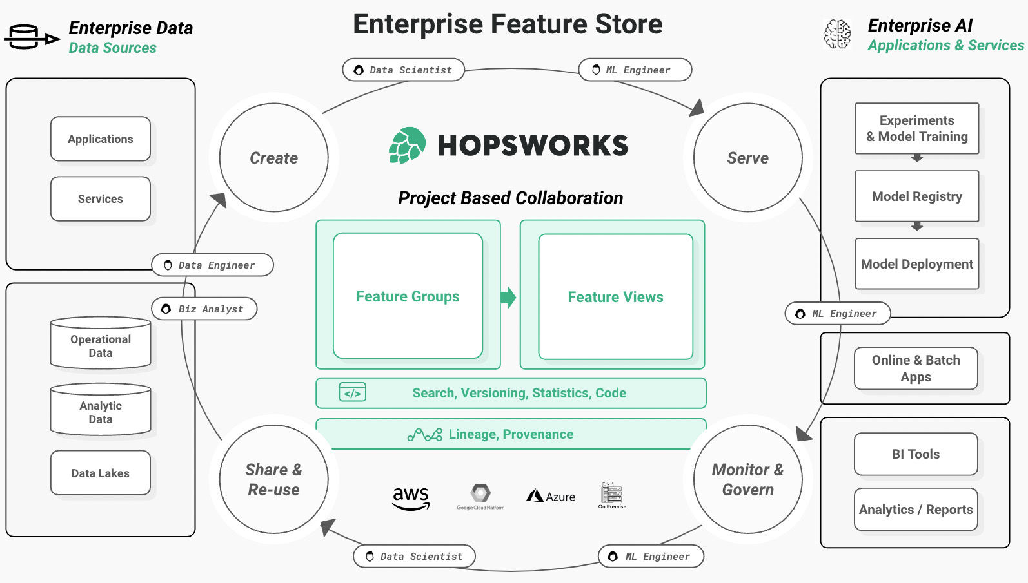
Hopsworks feature store
Industrial partner
Superior performance compared to existing cloud-based alternatives [1]
Online feature store and offline feature store [2]
[1] De La Rúa Martínez, Javier, Fabio Buso, Antonios Kouzoupis, Alexandru A. Ormenisan, Salman Niazi, Davit Bzhalava, Kenneth Mak, et al. 2024. “The Hopsworks Feature Store for Machine Learning.” SIGMOD/PODS ’24: Companion of the 2024 International Conference on Management of Data, May. https://doi.org/10.1145/3626246.3653389.
[2] https://docs.hopsworks.ai/latest/
Notes:
Freestyle

Slide 57
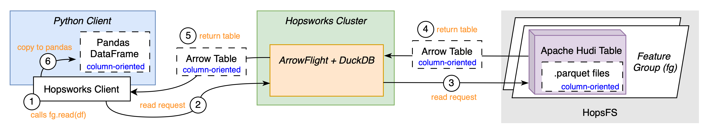
Legacy system - Reading

Slide 58
PyIceberg system - Reading

Slide 59
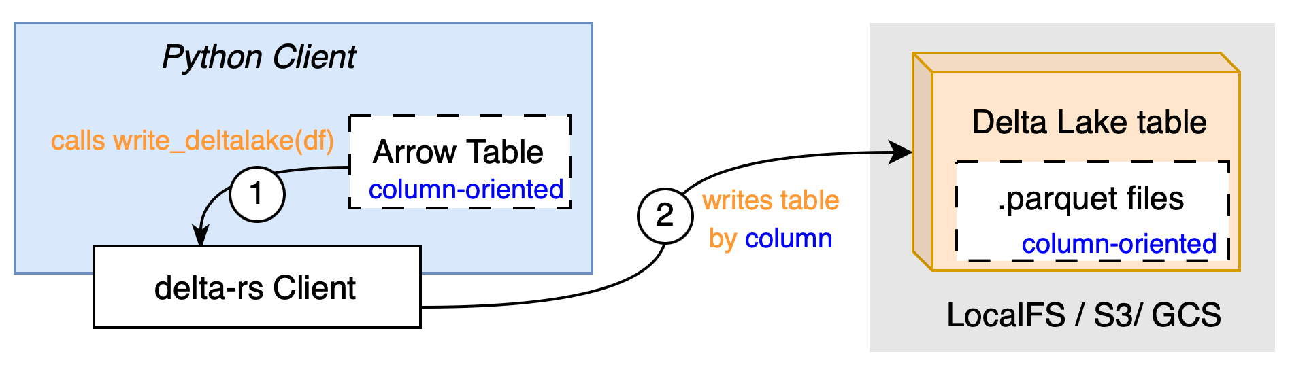
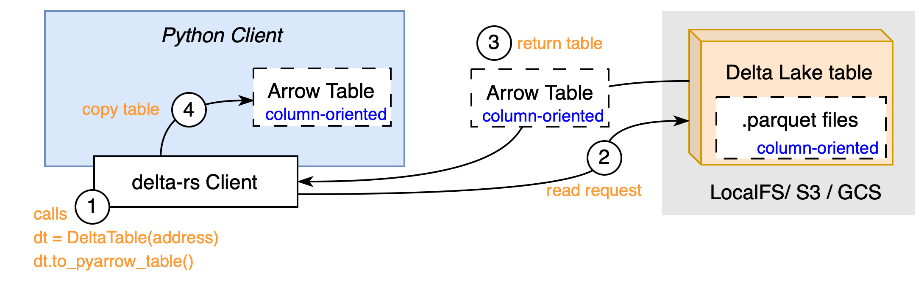
Other solution – delta-rs system
Developed in parallel to this master thesis
Uses Rust library called delta-rs to access offline feature store
Avoids usage of Spark
Remove middleware
Column-based transfer
Writing
Reading

Slide 60
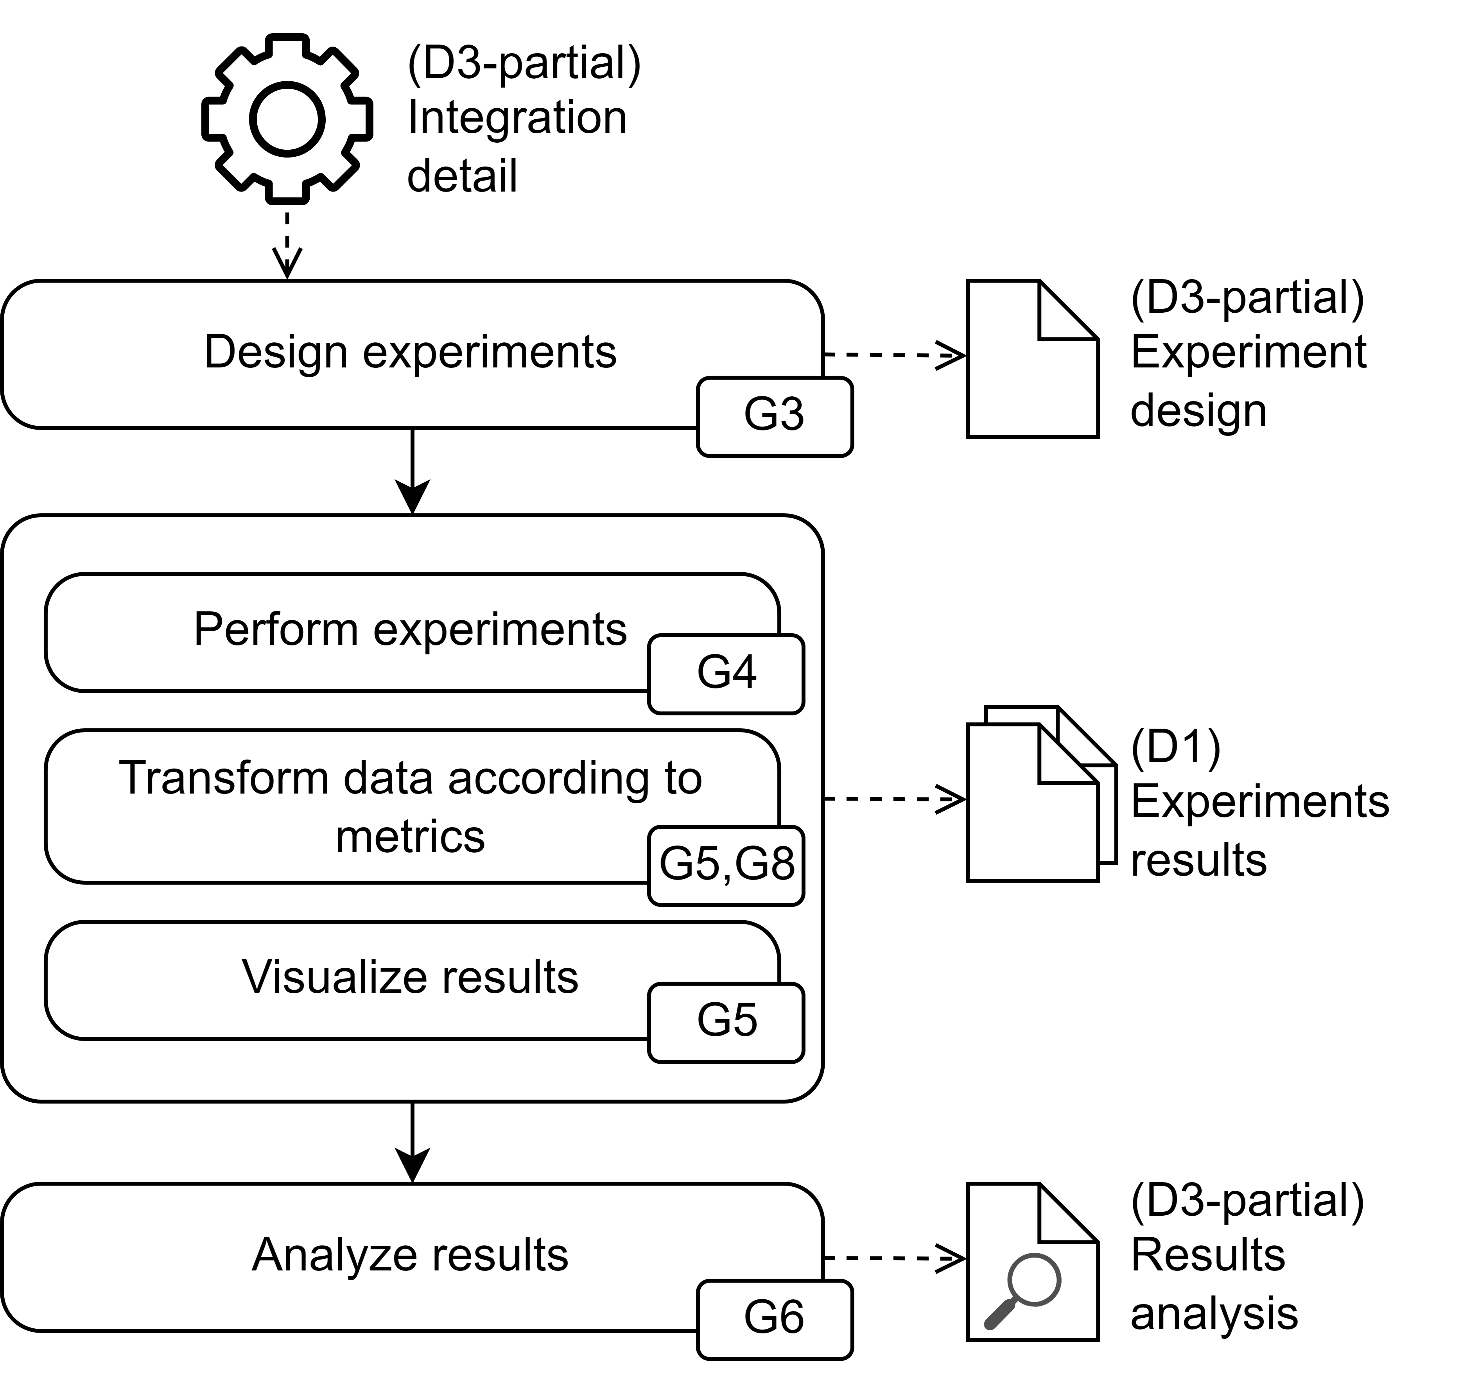
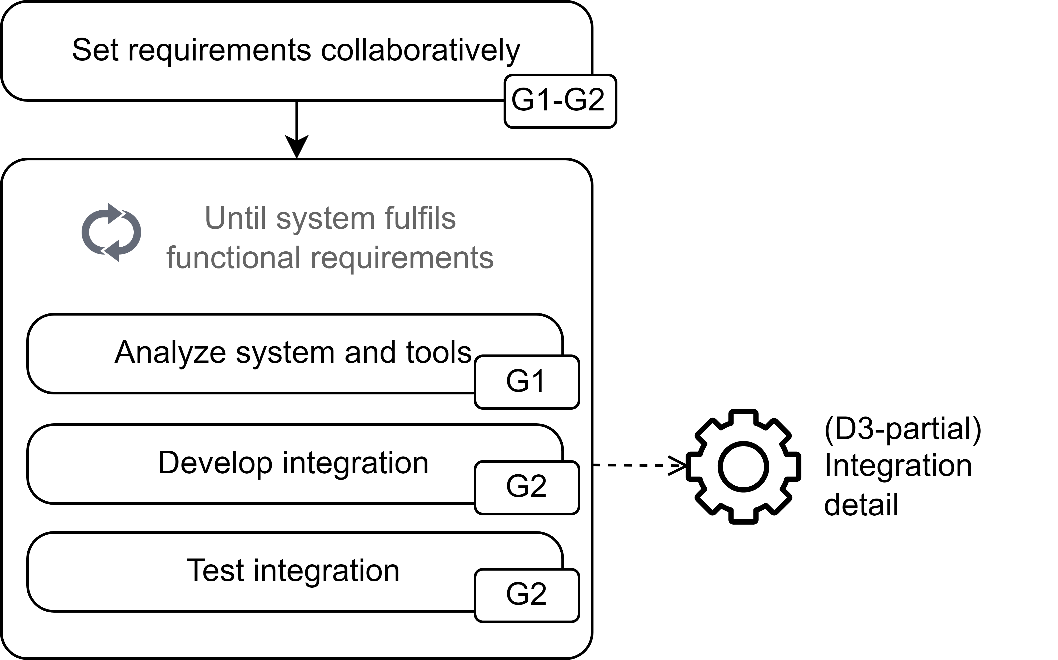
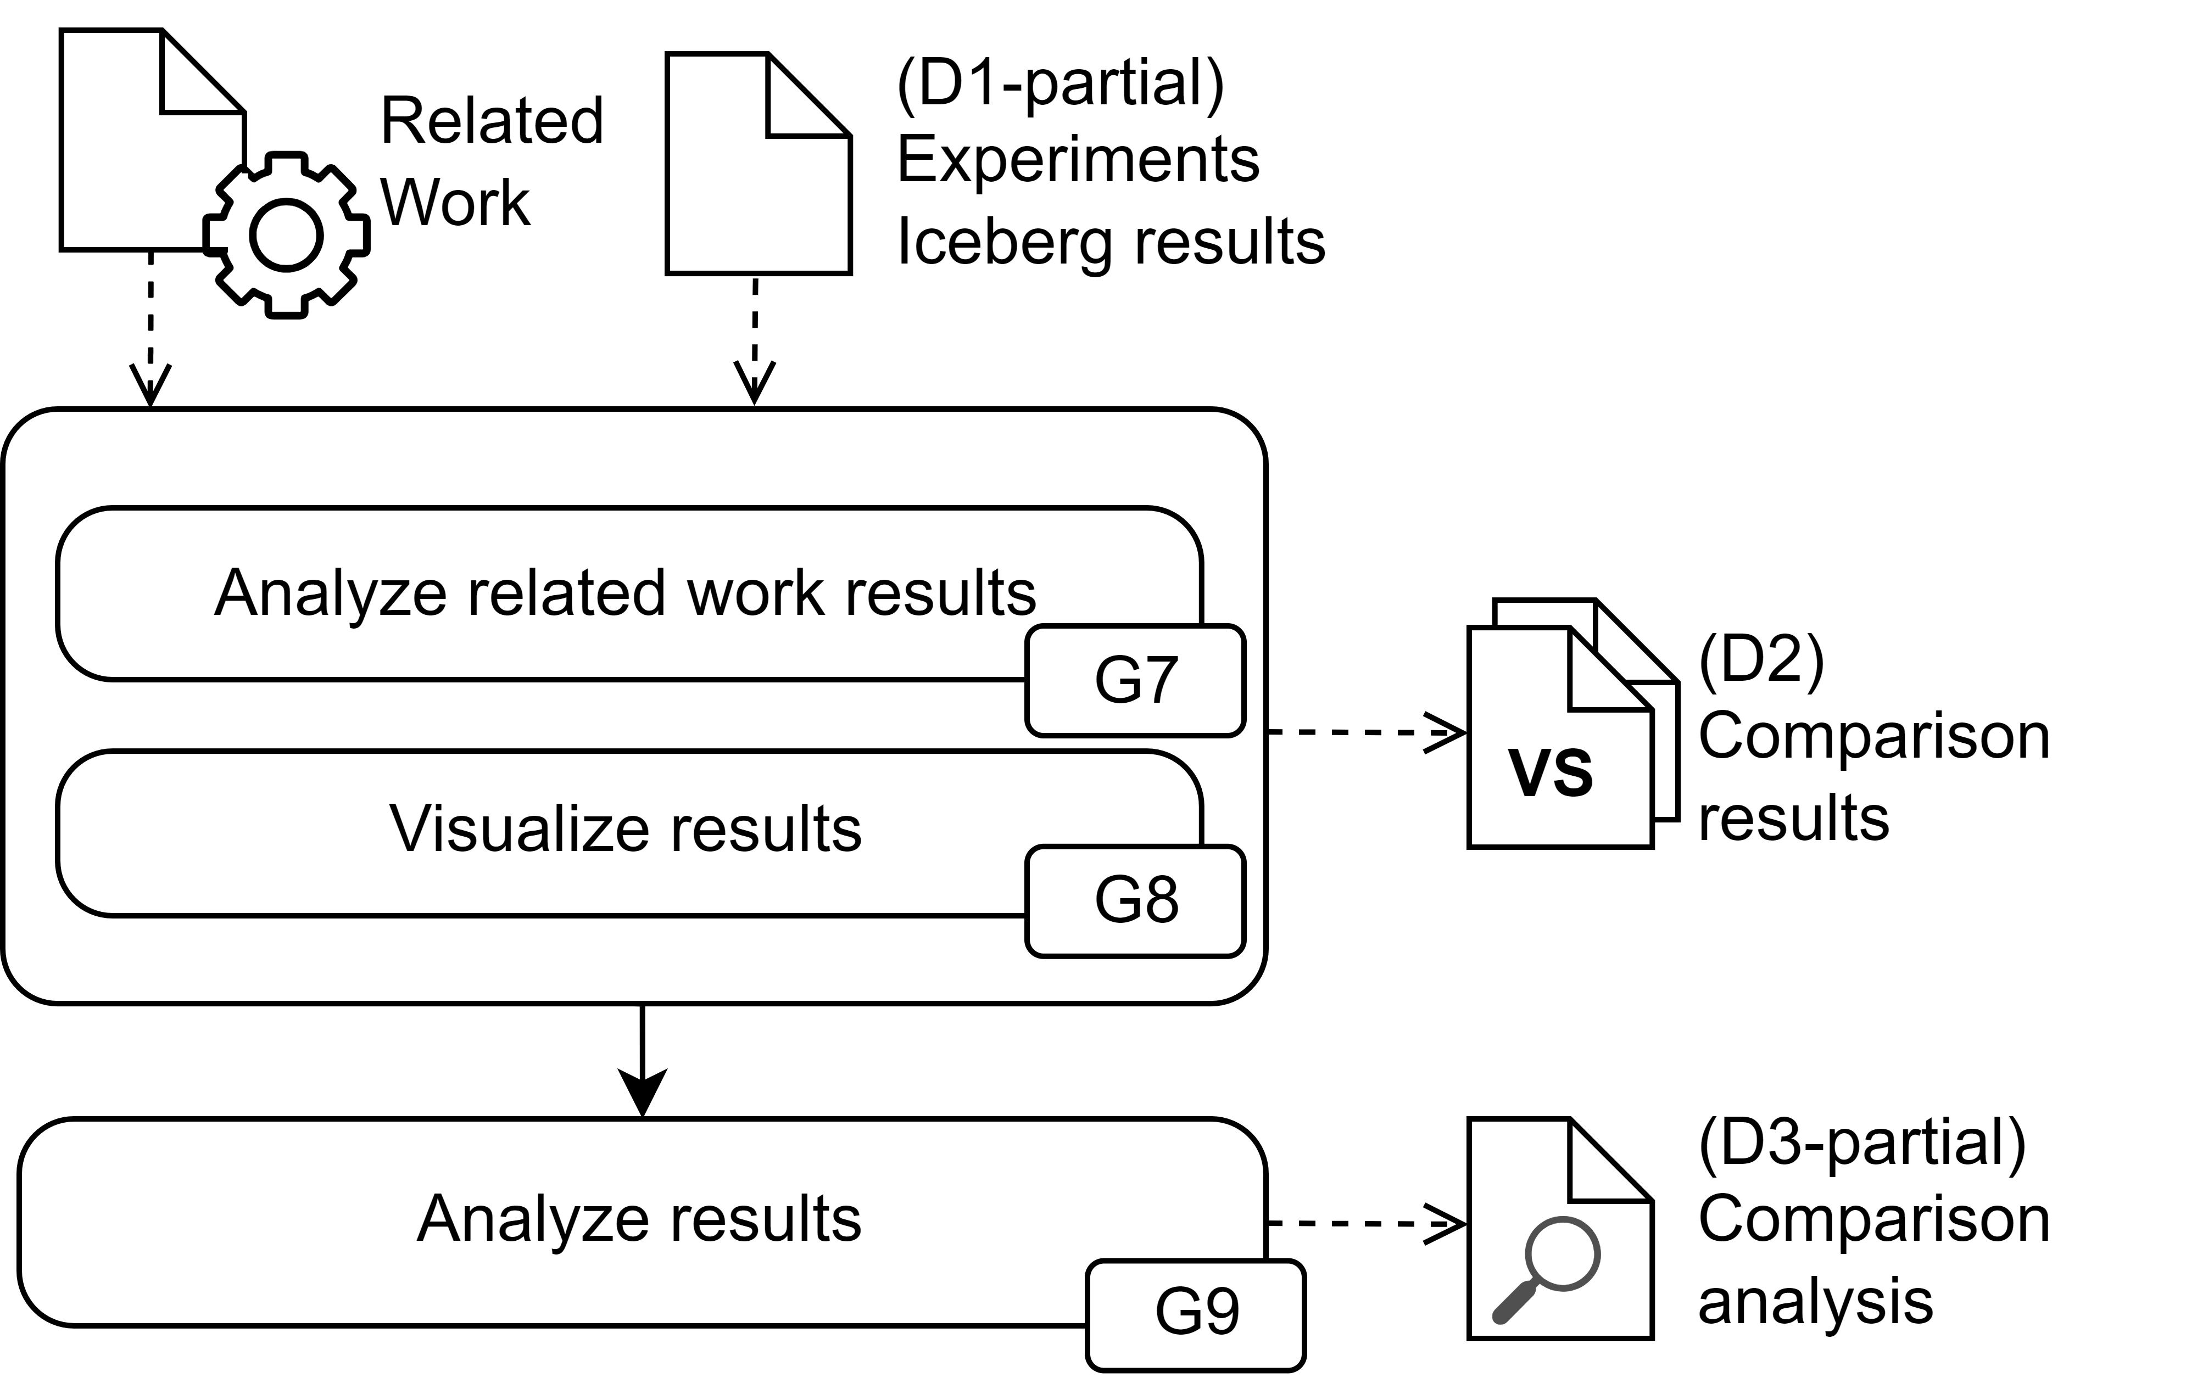
Method - Processes
Integration
Evaluation
Notes:
The method is divided in three subprocesses. Each process consists in specific activities, the one in the boxes, with the objective of fulfilling the Goals described, thus answering the Research questions. This is discussed in much more details in the thesis report, but shortly, the three subprocesses are:
A system integration, between PyIceberg and HopsFS, on the left
Two system evaluation, on the right: one consists in the evaluation of IcedHops against the legacy system, the second evaluates IcedHops against the delta-rs system.

Slide 61
Method – System integration RQ1 - Process
G1: Understand PyIceberg library tools and identify which are needed to interact with HopsFS.
G2: Implement interaction between PyIceberg and HopsFS.

Slide 62
Method – System evaluation RQ1 – Process
G3: Design the experiments to evaluate the performance difference between the legacy access to Apache Hudi and the PyIceberg library-based access to Apache Iceberg, on HopsFS.
G4: Perform the designed experiments.
G5: Visualize the experiments' results, focusing on an effective comparison of performances.
G6: Examine and describe the findings in a dedicated Section of the thesis report.

Slide 63
Method – System evaluation RQ2 – Process
G7: Investigate related work on delta-rs library-based access to Delta Lake, on \gls{HopsFS}.
G8: Visualize experiments' results of PyIceberg and delta-rs alternatives to the legacy system, focusing on an effective comparison of performances.
G9: Examine and describe the findings in a dedicated Section of the thesis report..

Slide 64
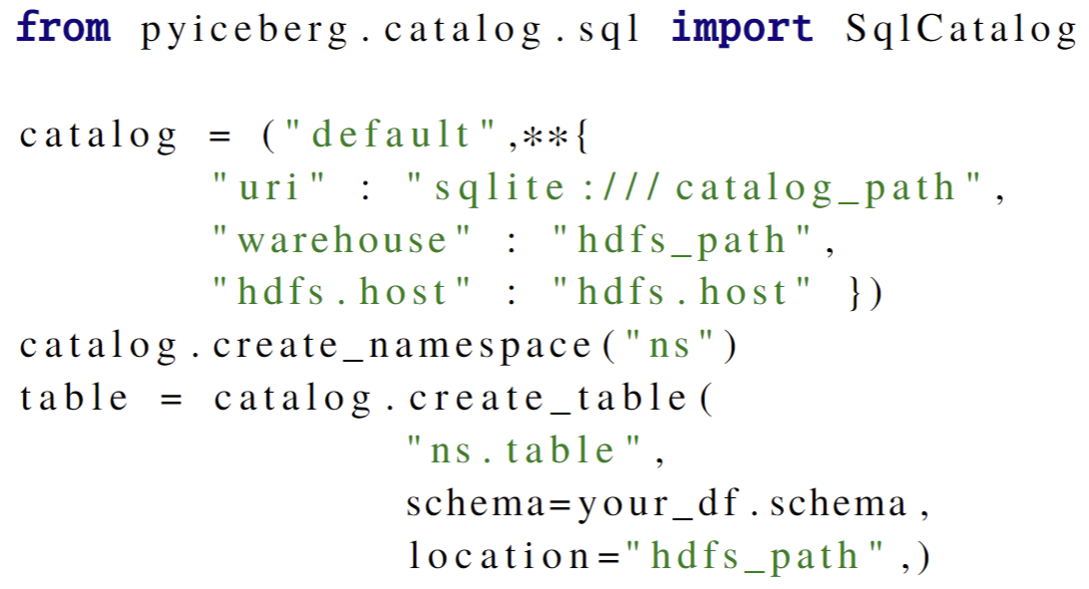
System integration – Usage(1/2)
Instantiate catalog

Slide 65
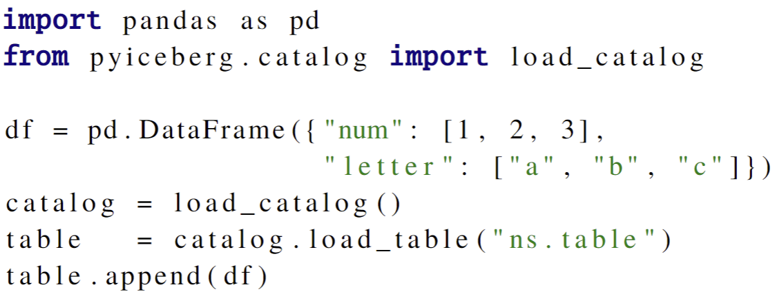
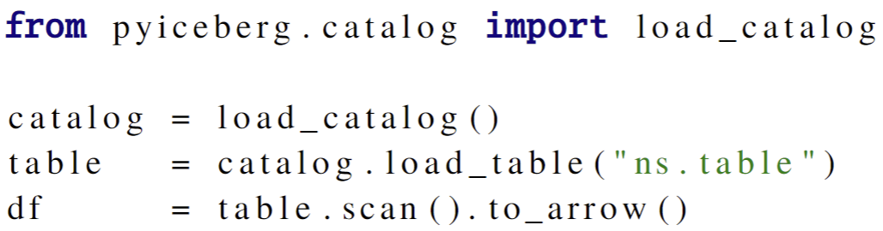
System integration – Usage (2/2)
Writing
Reading

Slide 66
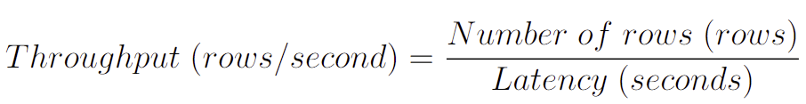
Experiments – Throughput
Latency is measured, while throughput is calculated as:

Slide 67
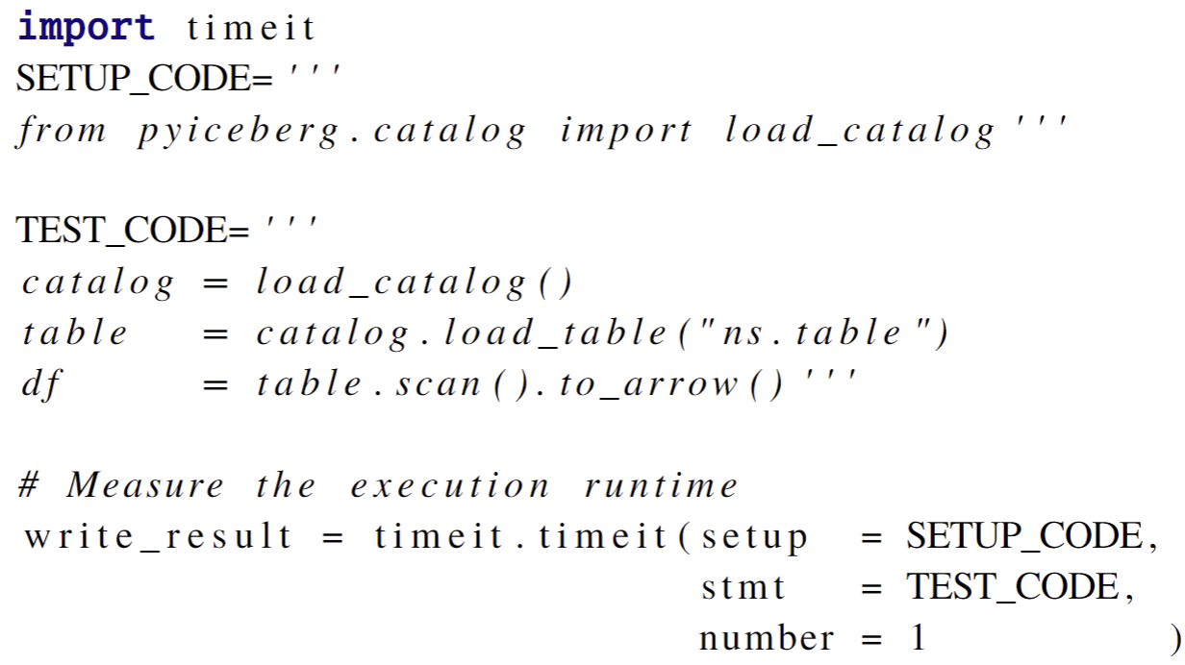
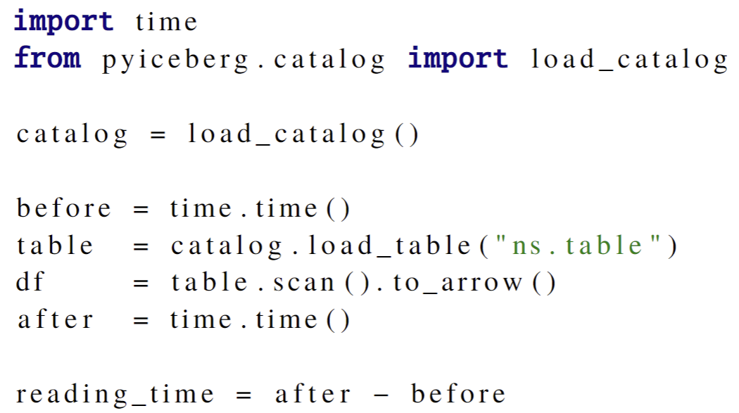
Experiments – Timing methods
Using timeit
Using time difference
Notes:
The time-it approach is slightly more accurate, thus it has been used when possible. However, sometimes, either due to legacy system functionalities, or due to specific features of the experimental environment, namely the resource caching, the time-it approach was not feasible, thus the time difference was used to measure latencies.

Slide 68
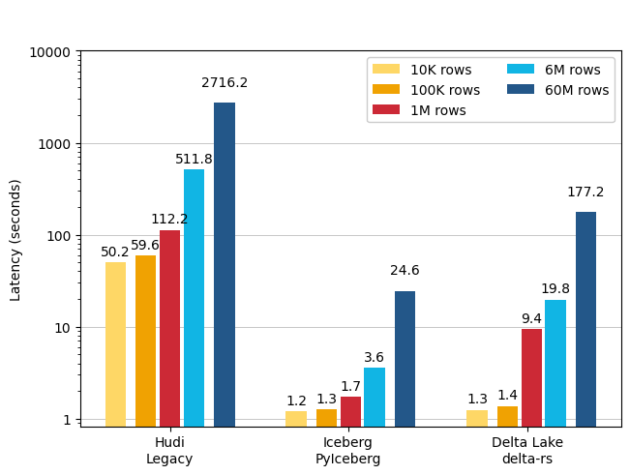
Results – Consideration
Log-scale
Latency only
Notes:
Some quick considerations to better understand the data we are going to see:
The log-scale is used on the graphs. This was chosen to outline differences in significant figures, making the visual comparison possible.
Secondly, trends will be described in latency only. Doubling the description of the trends with both the measurements makes little sense in this presentation. Those are however reported in the thesis report.

Slide 69
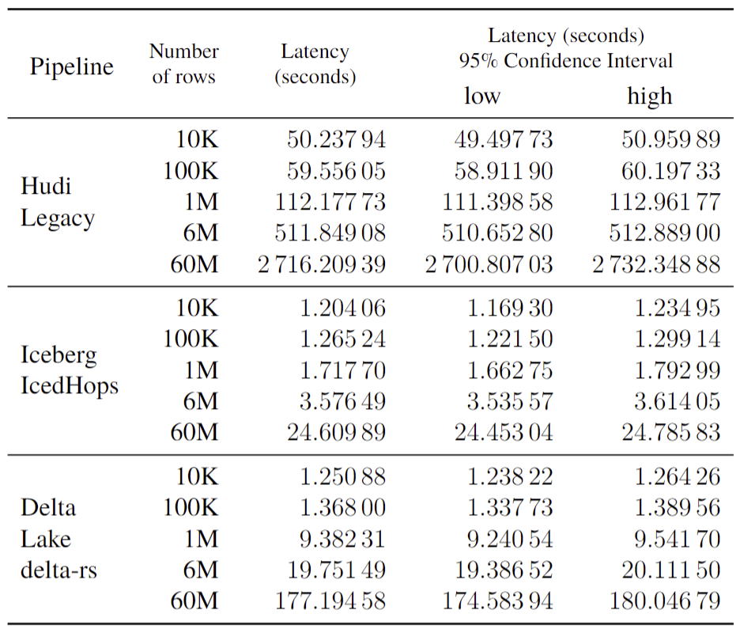
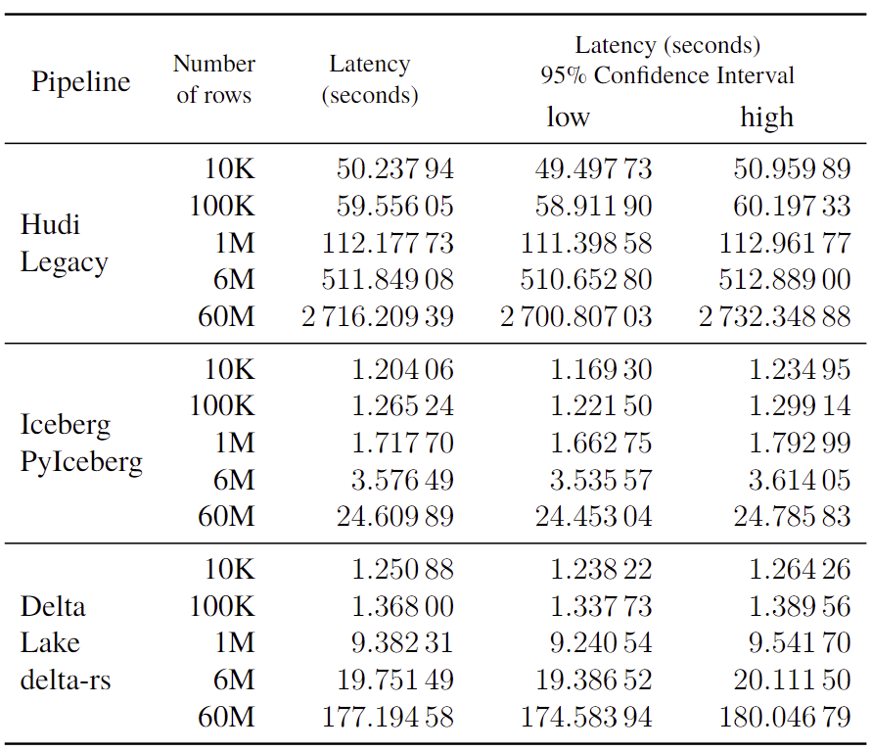
Results – Write latency – 1 CPU
Notes:
Just by having a look, IcedHops, showed in the middle, is clearly faster than the legacy system, as well as of the delta-rs alternative.

Slide 70
Results – Write latency – 1 CPU
Notes:
Looking at the smallest table, the 10K rows, both IcedHops and delta-rs performed nearly 40 times faster than the legacy system, with IcedHops slightly faster than delta-rs.

Slide 71
Results – Write latency – 1 CPU
Notes:
Looking at the biggest tables, containing 6 and 60M rows, we can see how IcedHops performs respectively 140 and 110 times faster than the legacy system. As well, IcedHops performed 7 times faster than the delta-rs alternative.

Slide 72
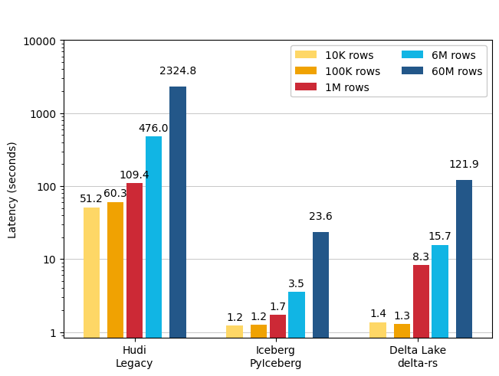
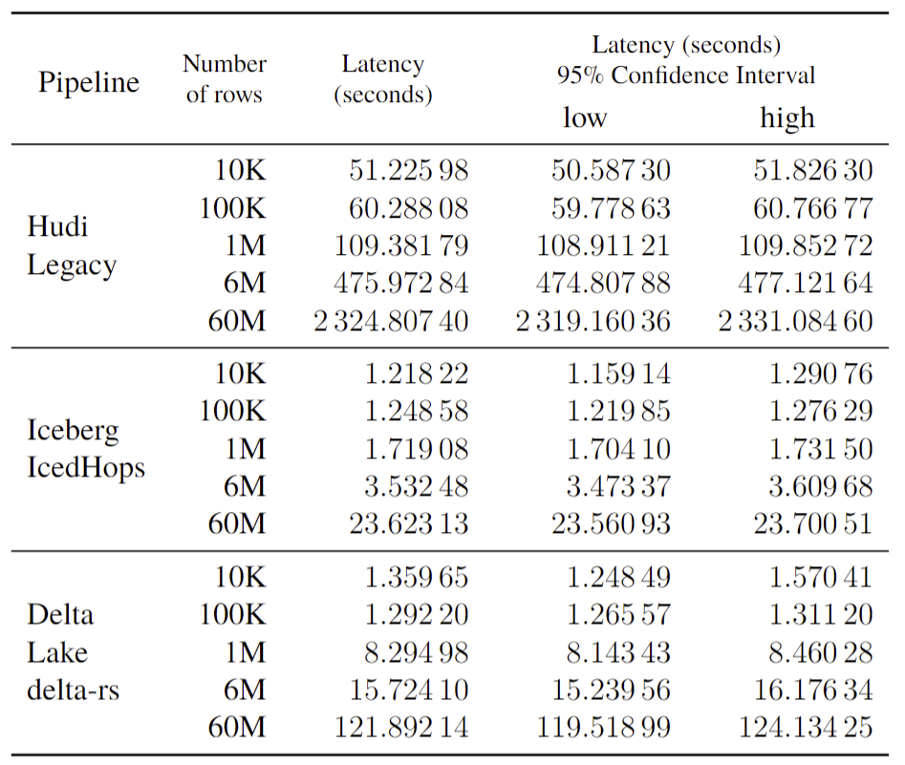
Results – Write latency – 8 CPU

Slide 73
Results – Write latency – 8 CPU
Notes:
The results is similar for write operations on 8 CPU settings. Iceberg is still performing hundreds time faster than the legacy-system, and performing 5 or 6 times faster than the delta-rs alternative, for the largest table.

Slide 74
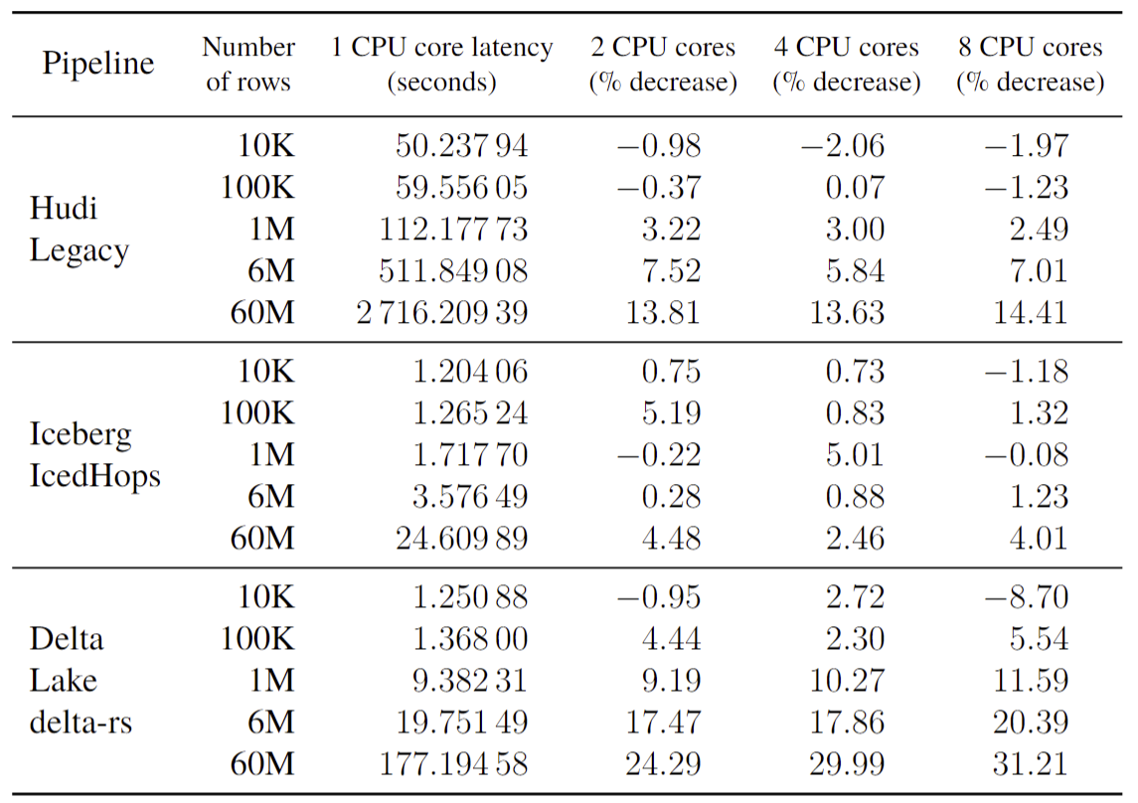
Results – Write latency – CPU comparison
Notes:
Let’s have a look at the comparison between different CPU settings on write operation latency, reminding that the four settings used are 1 CPU, 2 CPU, 4CPU and 8 CPU cores.

Slide 75
Results – Write latency – CPU comparison
Notes:
Despite IcedHops performed better than delta-rs and the legacy system in any CPU setting, for any tables size, it must be noted that the writing performances barely increase of few percentages point when increasing the amount of CPU cores. Instead, the legacy system notices a notices a moderate increase, and the delta-rs and increase of 24% and up to 31% percent for the 60M rows table.
In any case, all the information represented shows a trend of diminishing rates of return. Taking for example the case of delta-rs on 60M rows table, by adding a CPU I get 24% better performances, adding 3 CPUs I get 30% better performance (accounting for 10% nominal increase), and adding 7 CPUs I get 31% better performance (accounting for only 4.5% of nominal increase).

Slide 76
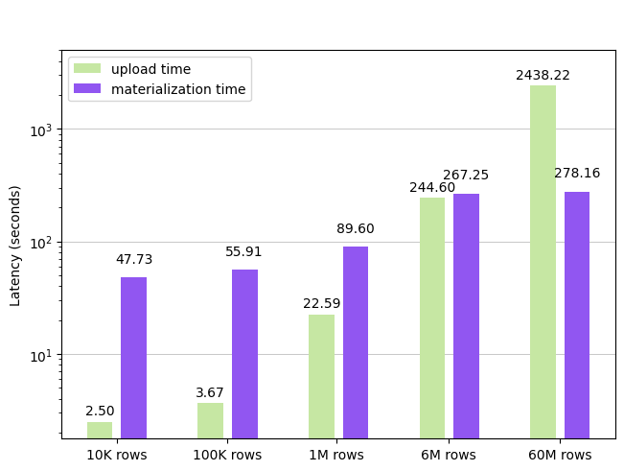
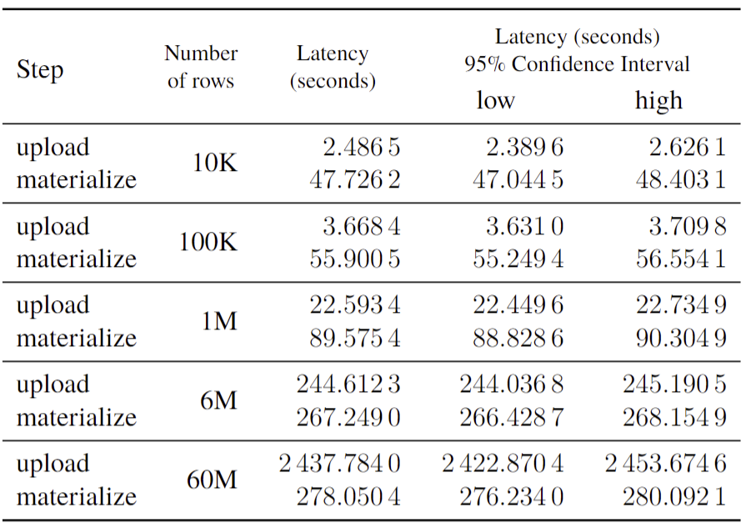
Results – Upload vs. Materialization – 1 CPU
Notes:
Further analysing the reasons behind the enormous latency exhibited by the legacy system on write operations, the upload and materialization time has been divided and studied separately. The first one accounts for the time needed to upload the data, row by row, on Kafka. The second one, accounts for the time needed by the Hudi delta streamer’s Spark job to materialize the data into Hudi tables, reading data from Kafka.
We can notice that the upload time grows linearly with the number of rows, while the upload time follows and almost logarithmic trend. Thus, at the beginning, while with the smallest table the upload time accounts for only the 4% of the total time, with the smallest table it accounts for 95% percent of the total time, with an even contribution only around 6M rows.

Slide 77
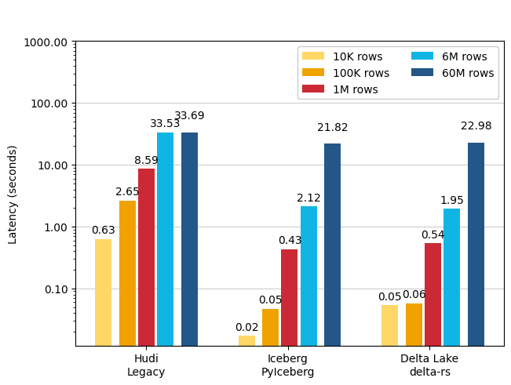
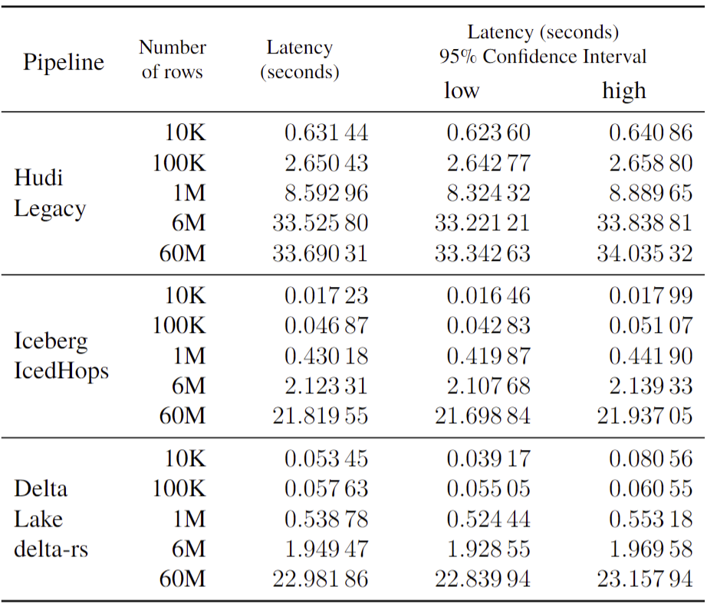
Results – Read latency – 1 CPU
Notes:
Moving now on the results of the read latency, we can see that while there still a great difference in some table sizes, the performance gap between IcedHops and the legacy system is smaller. In this case, IcedHops performed almost equally to delta-rs.

Slide 78
Results – Read latency – 1 CPU
Notes:
Closely looking at the smallest table, the 10K rows, IcedHops performed 40 times faster than the legacy system, and circa 3 times faster than delta-rs.

Slide 79
Results – Read latency – 1 CPU
Notes:
However, looking at the biggest table, containing 60M rows, IcedHops performed 55% faster than the legacy system, and behave almost identically to the delta-rs alternative.

Slide 80
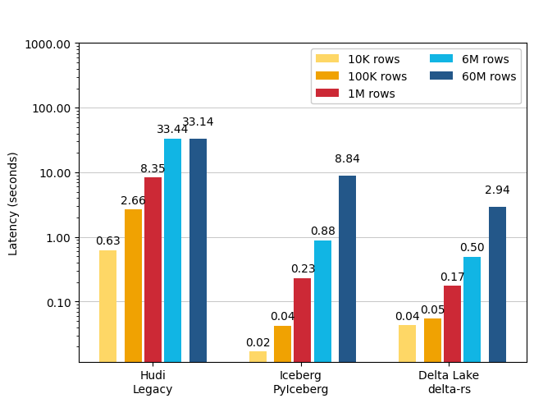
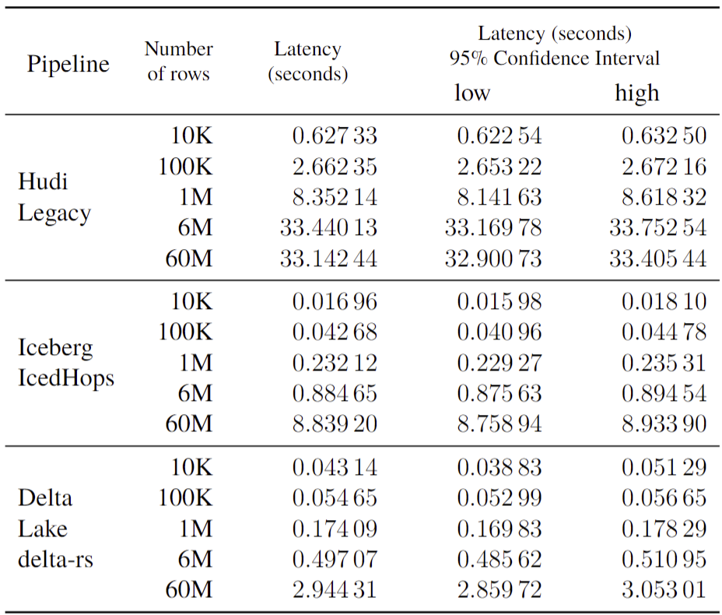
Results – Read latency – 8 CPU
Notes:
Looking at 8 CPU core setting, we see that the performance gap between IcedHops and the legacy system results significantly bigger. As well, delta-rs performed better than IcedHops in two specific measurements.

Slide 81
Results – Read latency – 8 CPU
Notes:
Looking closer at the results of the largest table, 6M and 60M rows, we can see that IcedHops performed respectively 40 and 4 times faster than the legacy system. At the same time, IcedHops performed respectively 60% and 3 times slower than the delta-rs alternative.

Slide 82
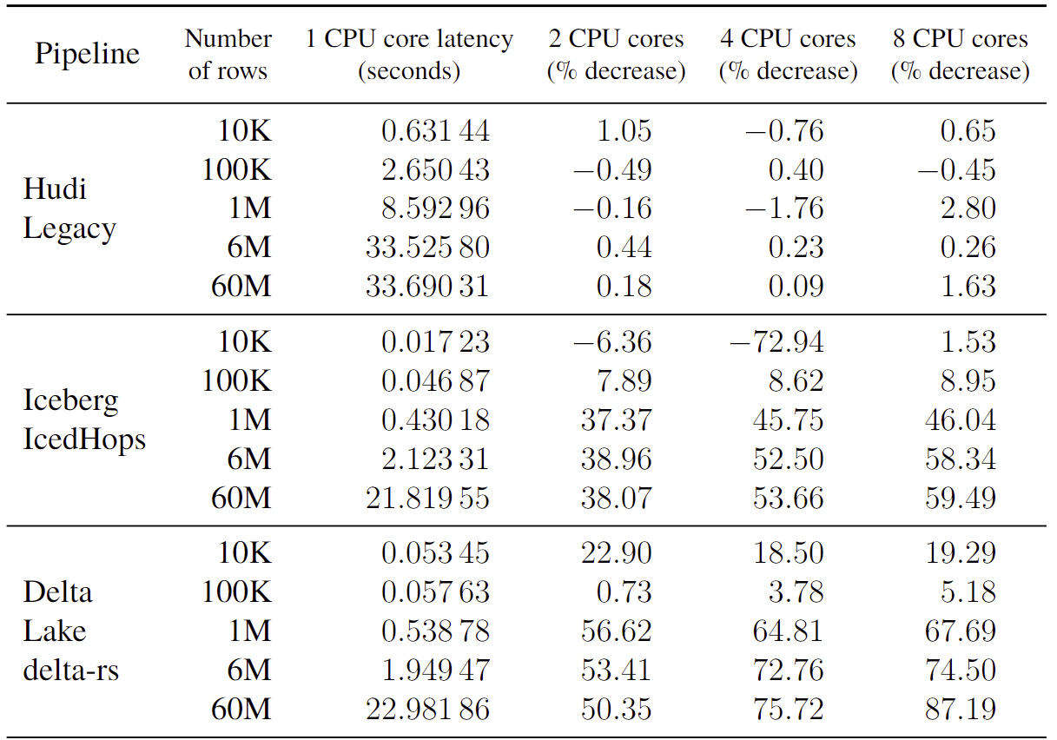
Results – Read latency – CPU comparison
Notes:
Let’s take the results of the different CPU settings on read operation latency.

Slide 83
Results – Read latency – CPU comparison
Notes:
In this case, the legacy system do not practically see any improvement with the increasing amount of CPU cores. In the other hand, both IcedHops and delta-rs experience a great improvement, with respectively 38% and 50% latency decrease. Despite the great result, also in the case of read operations, we can notice a diminishing rate of return, when increasing the amount of CPU cores.

Slide 84
Results – Write vs. Read – 1 CPU
Notes:
PyIceberg provides much better linearity between the three

Slide 85
Results – Write vs. Read – 8 CPU

